Slide 1
Introduction to Cybersecurity
Sreya Vangara

Slide 2
Modulus Arithmetic

Slide 3
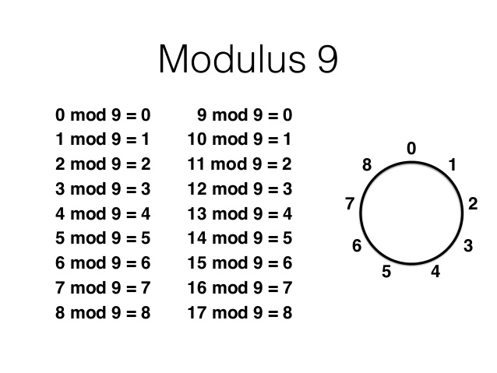

Slide 4
Encrypted Communication

Slide 5
Diffie-Hellman Key Exchange
The Diffie–Hellman key exchange method allows two parties that have no prior knowledge of each other to jointly establish a shared secret key over an insecure channel. This key can then be used to encrypt subsequent communications using a symmetric key cipher.
https://youtu.be/YEBfamv-_do?t=145

Slide 6
Let’s Try It!

Slide 7
RSA
Choose two (usually large) primes, p and q
Compute a value N = p*q, commonly referred to as the modulus
Compute phi(N) = (p-1)*(q-1)
Choose a "public exponent value", denoted e. Typically this is 3 or 65537.
Compute d, the "private exponent value" which is the multiplicative inverse of e mod(phi(N))
To encrypt a message m, compute m^e mod (N)
To decrypt a ciphertext c, compute c^d mod (N)
https://youtu.be/wXB-V_Keiu8?t=119

Slide 8
Problem
A spy sent an RSA-encrypted message (“handout”). We got their key data, but we're not very good at math. Can you decrypt it? Note that the flag is not a number but a number decoded as ASCII text.
Hint: Free code
def int2Text(number, size):
text = "".join([chr((number >> j) & 0xff)
for j in reversed(range(0, size << 3, 8))])
return text.lstrip("\x00")

Slide 9
Problem
Find the flag from rsa1.txt

Slide 10
Totally Unrelated Problem
Figure me out! {r_wlmg_vevm_mvvw_zm_zhxrr_gzyov}

Slide 11
Another Unrelated Problem
Find the flag in “unrelated-2”
Hint 1: Decode the file
Hint 2: What kind of encoding methods did we discuss
Hint 3: What numerical encoding methods exist other than base 2, 8, 16?

